Slide 1

Smart Device Growth Opportunities
What can trends in smart device use tell us about marketing opportunities?
Richard Overman
02/02/26

Slide 2

Purpose: Find Trends in Smart Device Data
Data Used: FitBit Fitness Tracker Dataset: https://www.kaggle.com/datasets/arashnic/fitbit
Data Preparation: Merging of Daily Activity and Sleep Datasets
Analysis: Comparison across multiple categories, day of week, time of day.

Slide 3
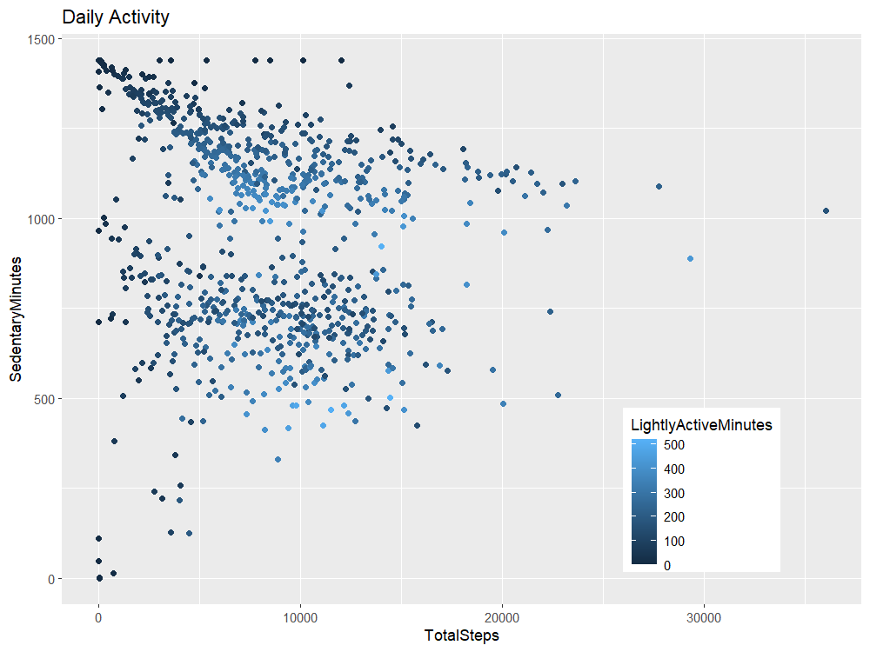
Total population of samples in Daily Activity dataset.
Top population includes devices with 24 hours (1440 minutes) of sedentary minutes – devices not worn all day.
Bottom population suspected to be devices worn 24 hours.

Slide 4
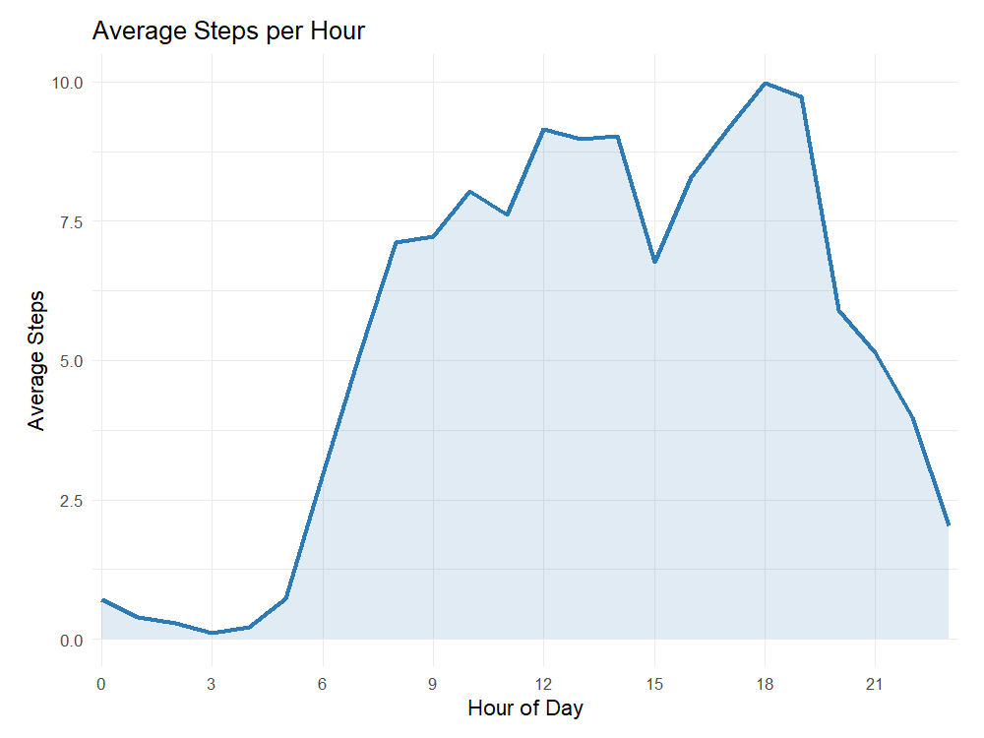
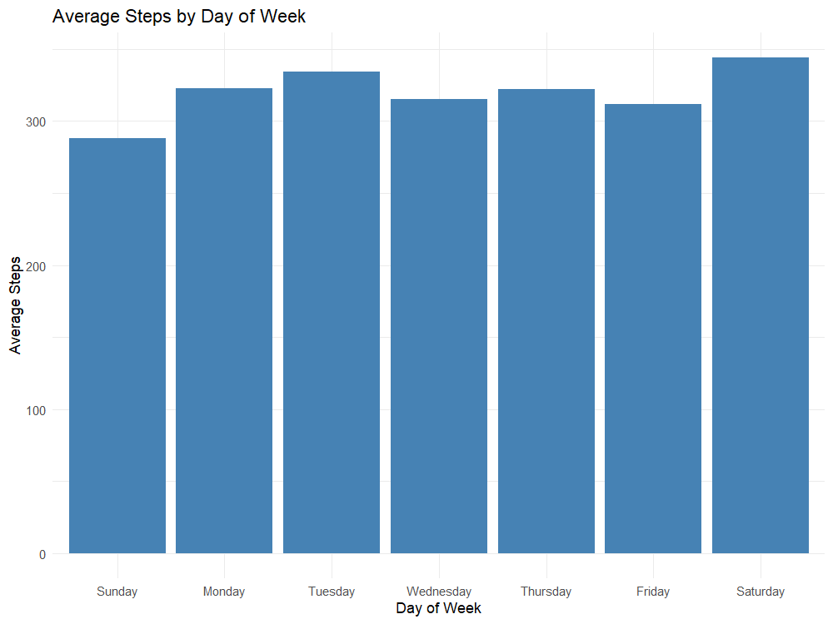
Average Usage per Day / Week

Slide 5
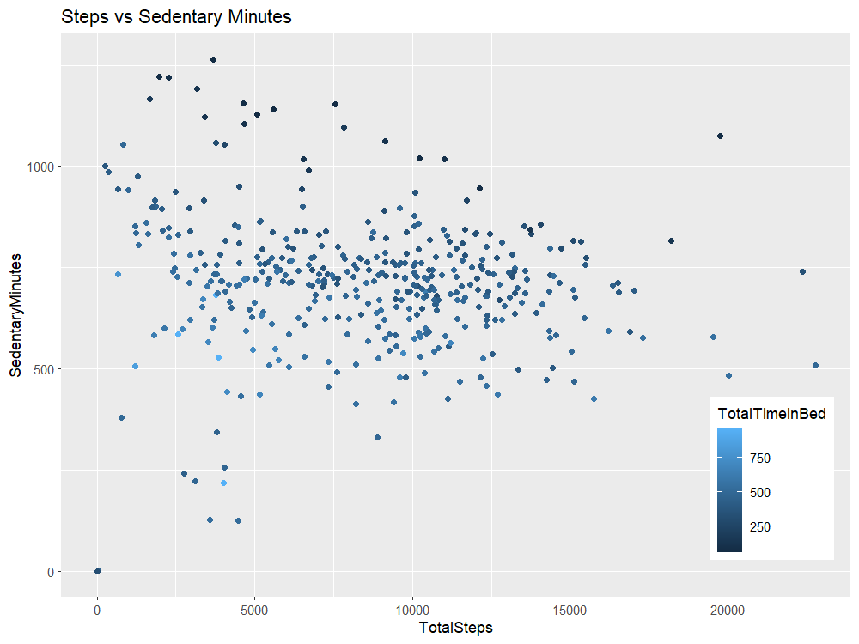
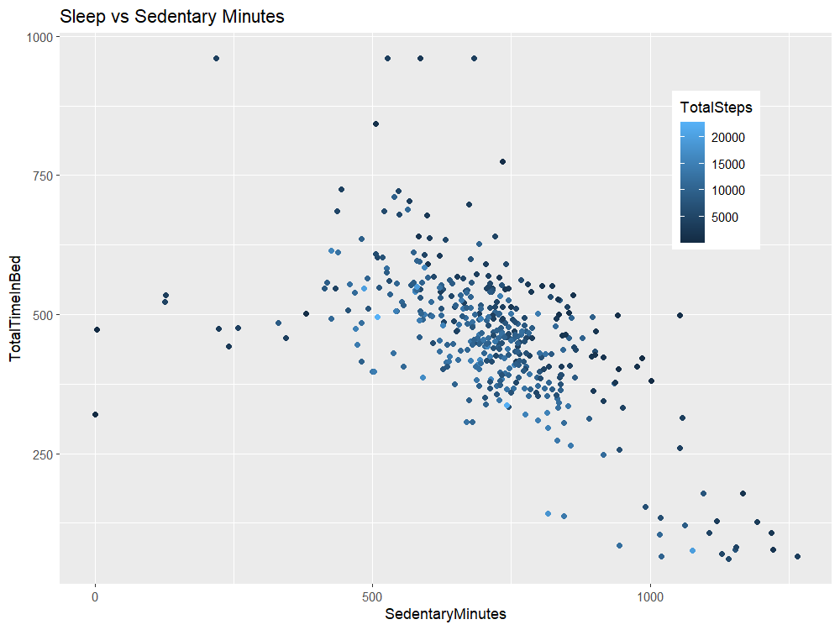
Merged Daily Activity with Sleep Data

Slide 6
Recommendations
Focus advertising on Saturdays.
Focus advertising close to 6pm.
Emphasize improvements to fitness from ability to track sleep.

